Slide 1

A Self-Tuning (Iterative) Fill Factor Technique for SQL Server
Mike Byrd

Slide 2


Mike
Byrd
Dirty Byrd
Database Engineer
ByrdNest Consulting
Sunrise Beach, Texas
Former AF Fighter Pilot, Rocket Scientist, and now SQL Server Geek. Specialize in SQL Server performance tuning. I’m currently self-employed and consult part-time. I’ve had one client for 15+ years.
Mbyrd@ByrdNest-TX.com
www.TSQLMentoring.com
Notes:
Peter

Slide 3


Slide 4
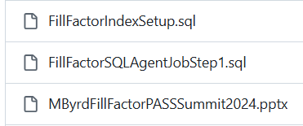
Presentation slides and T-SQL code are available at https://github.com/MByrdTX
You don’t need to take notes; just listen and review slides and scripts later.

Slide 5




Who is Mike Byrd
In former times
Rocket Scientist (MSE in rocket propulsion @ Purdue;
3 yrs Air Force Rocket Propulsion Laboratory)
USAF Fighter/Instructor/Operational Test Pilot (F-4)
Free-lance tech writer for PC Magazine
CTO, Texas Windstorm Insurance Company
Part-time Database Consultant/Trainer
Pre-covid blogging at https://Logicalread.com & Http://www.sqlservercentral.com
Digging deeper into the optimizer black box

Slide 6
Overview
Fill Factor
What is it?
How is it used?
Approach
Short Review of Code
Analysis
Conclusions/Observations
No Demos ☹

Slide 7
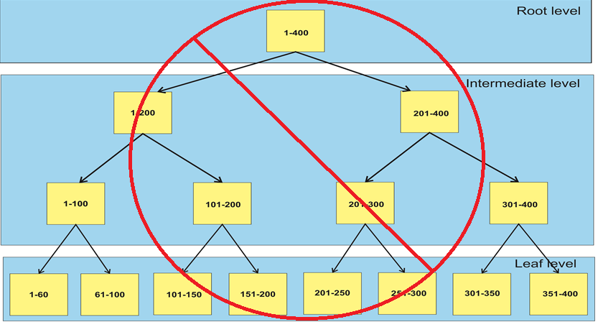
Index Structure (B-Tree) – not exactly correct!

Slide 8
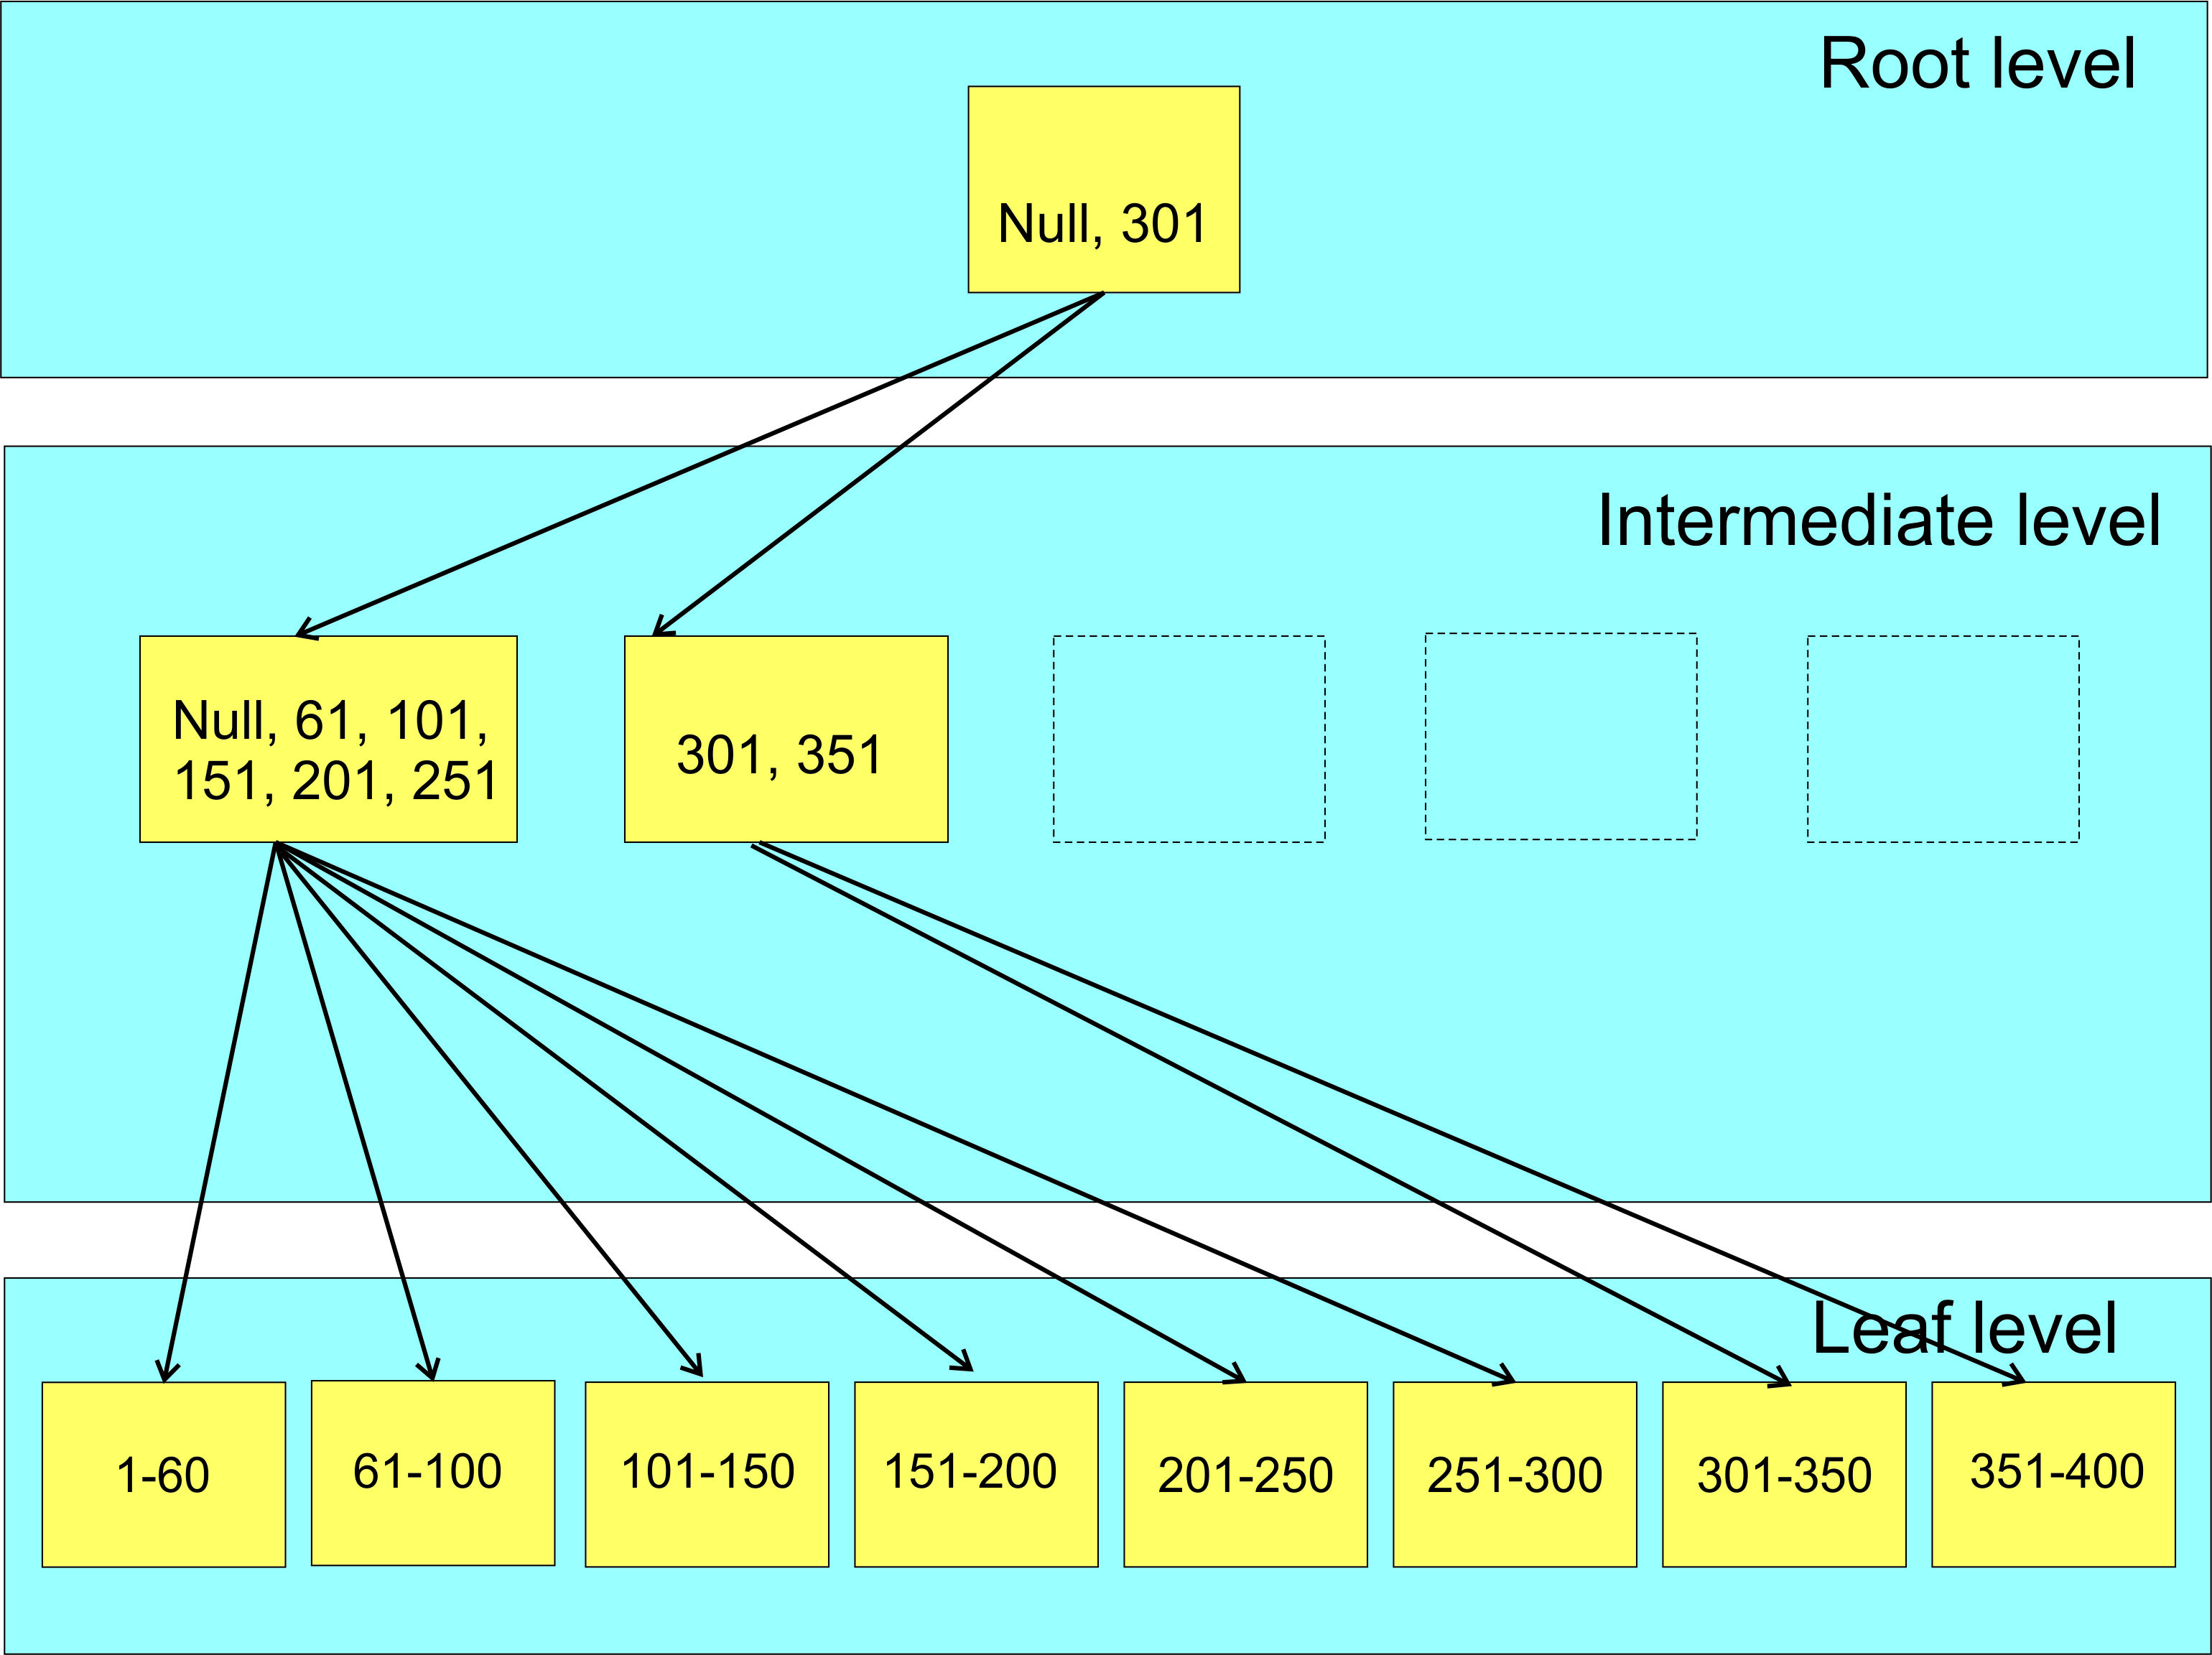
Index Structure (B-Tree)

Slide 9

Fill Factor
Percent of fullness of leaf level pages of an index
So what happens when a page cannot accommodate a new row?

Slide 10
SQL Server Fill Factor
SQL Server Fill Factor
Good Page Splits

Slide 11
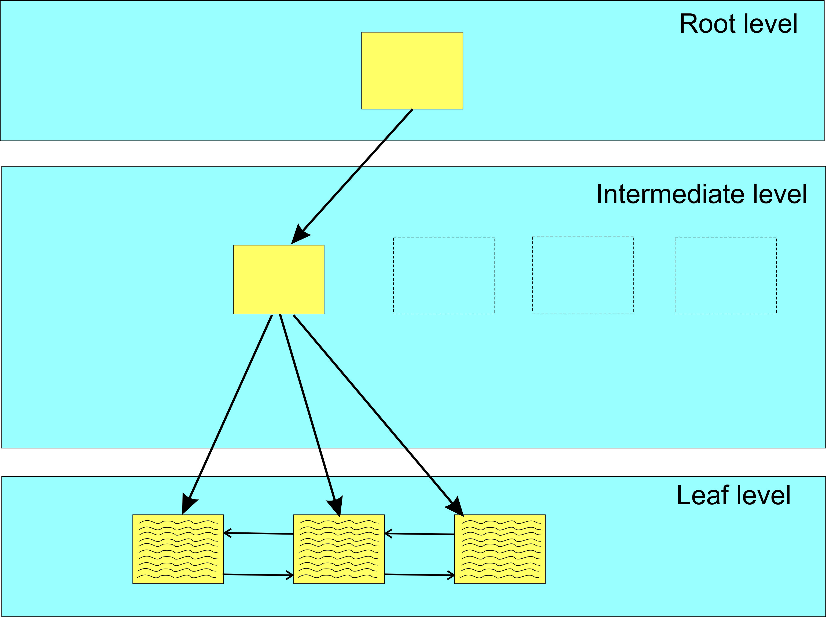
Partial view of B-Tree before adding row
.

Slide 12
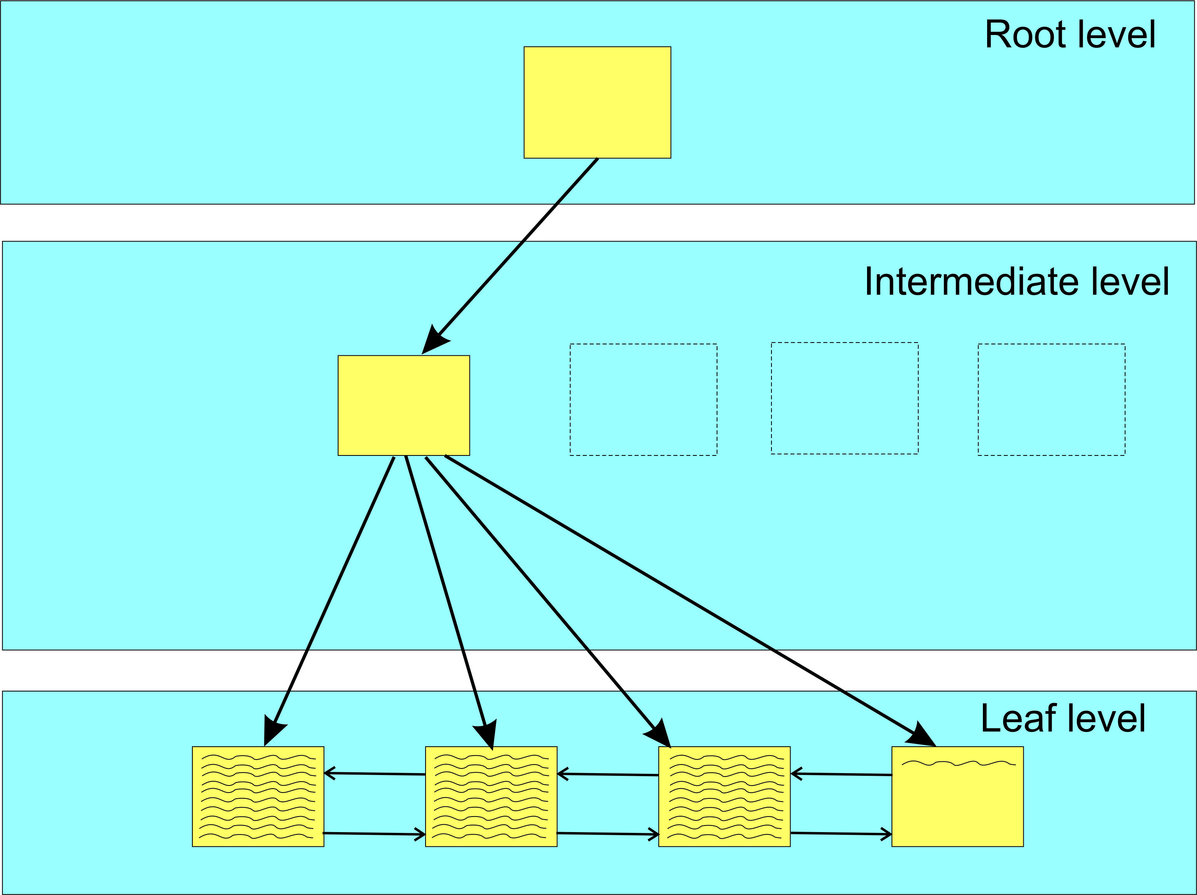
After adding row to index (Identity column)
.
Good Page Split

Slide 13
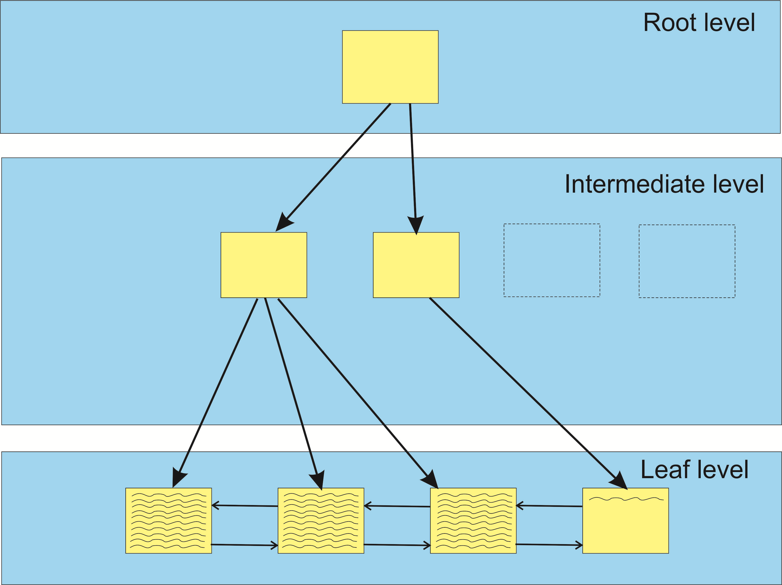
After adding row to index (Identity column, Inter. node expansion)
.
Good Page Split

Slide 14
SQL Server Fill Factor
SQL Server Fill Factor
Good Page Splits
Bad Page Splits
Case study at https://www.sqlservercentral.com/articles/how-bad-are-bad-page-splits
Avg bad page split: cpu=0.035ms, logical IOs = 6.1

Slide 15
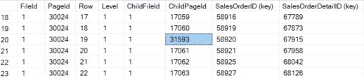
SQL Server Fill Factor
Bad Page Splits continued
And another case study at https://www.sqlservercentral.com/articles/how-bad-are-bad-page-splits-the-rest-of-the-story

Slide 16
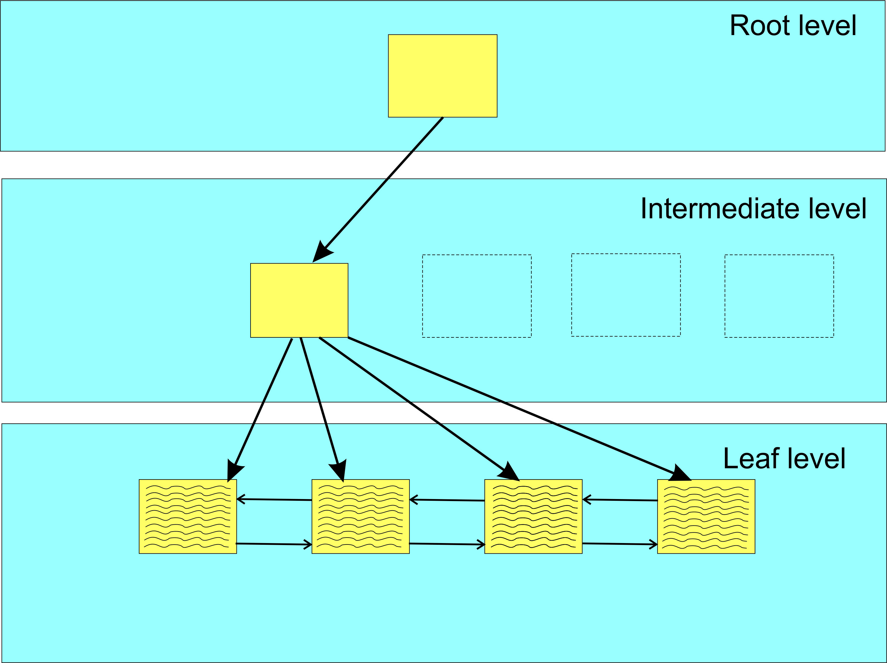
Bad Page Split Example (before row insert, rows aligned with extent)
.

Slide 17
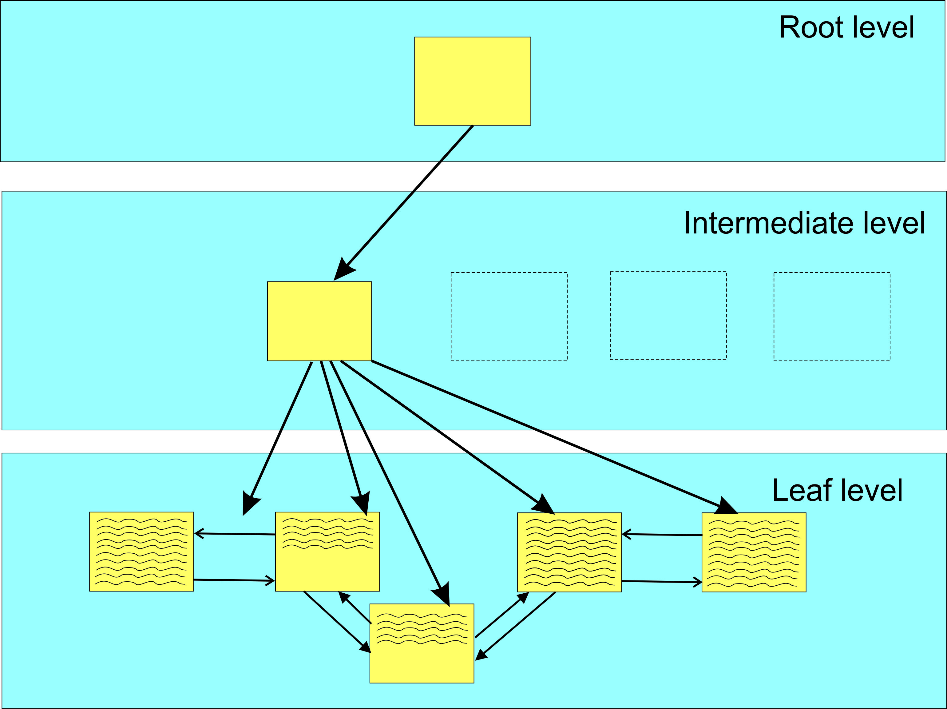
Bad Page Split Example (after row insert, rows not aligned with extent)
.
All the moved data
logged in transaction log
Bad Page Split

Slide 18
Bad Page Split
SQL Server Fill Factor
Good Page Splits
Bad Page Splits
Case study at https://tinyurl.com/yd8mcmvk
Avg bad page split: cpu=0.035ms, logical IOs = 6.1
The trick is to find a fillfactor value that minimizes bad page splits but doesn’t result in an excessive storage penalty.

Slide 19
Background
About 10 years ago I really dove into indexes and their effect on performance
But I have never really understood how to determine the fill factor for an index
Some guidance, but no definite path
Just no definitive guidance!
What to do????

Slide 20


In a time long, long ago…..

Slide 21
46 years ago at the Air Force Rocket Propulsion Laboratory
I took charge of a new group of 5 engineers to do computer simulations using AF requirements to specify new rocket propulsion technology for new air-to-air missiles
Purpose was to tell the rest of the Lab what technologies to invest in
Simulation using various missile simulation profiles to fly the shortest time to engage target aircraft
Involved in iterating on various rocket propulsion parameters
Propellant, size, weight, Chamber pressure, boast profile
Also different mission profiles
Max distance head on
Various engagements not head-on
Required saving each of the iteration parameters to identify “best” performance

Slide 22
Background
In April 2019, at SQL Saturday 830 (Colorado Springs), I attended two sessions by Jeff Moden titled “Black Arts” & Index Maintenance: How the “Best Practice” Methods are Silently Killing Performance.
Both were outstanding
The bad news is that the links to access those presentations are gone.
Good news is one of his later presentations (same subject) at https://www.youtube.com/watch?v=rvZwMNJxqVo

Slide 23
Background
In April 2019, at SQL Saturday 830 (Colorado Springs), I attended two sessions by Jeff Moden titled “Black Arts” Index Maintenance: How the “Best Practice” Methods are Silently Killing Performance.
Both were outstanding
The bad news is that the links to access those presentations are gone.
Good news is one of his presentations at https://www.youtube.com/watch?v=rvZwMNJxqVo
A Reader’s Digest version of his presentations is contrary to the popular concept of reorganizing at 10% fragmentation and rebuilding indexes at 30%.

Slide 24
Background
In April 2019, at SQL Saturday 830 (Colorado Springs), I attended two sessions by Jeff Moden titled “Black Arts” Index Maintenance: How the “Best Practice” Methods are Silently Killing Performance.
Both were outstanding
The bad news is that the links to access those presentations are gone.
Good news is one of his presentations at https://www.youtube.com/watch?v=rvZwMNJxqVo
A Reader’s Digest version of his presentations is contrary to the popular concept of reorganizing at 10% fragmentation and rebuilding indexes at 30%.
He showed (in the 2 presentations) that page splits caused tremendous performance degradations and that you should probably rebuild indexes at 1% fragmentation.

Slide 25
Background
On the flight back home, I got to thinking about everything he said and how fill factor also “factors” into index performance and maintenance.

Slide 26
Background
On the flight back home, I thought about everything he said and how the fill factor also “factors” into index performance and maintenance.
It got me thinking about a brute force optimization technique (iterative) I implemented way back when I worked at the Air Force Rocket Propulsion Laboratory (yes, I was once a rocket scientist and still a geek!).

Slide 27
Background
On the flight back home, I thought about everything he said and how the fill factor also “factors” into index performance and maintenance.
It got me thinking about a brute force optimization technique I implemented way back when I worked at the Air Force Rocket Propulsion Laboratory (yes, I was once a rocket scientist and still a geek!).
It was a technique that involved tweaking various parameters (iterating plus and minus percentages) and reducing the tweaks to an “optimum” solution.

Slide 28
Background
On the flight back home, I thought about everything he said and how the fill factor also “factors” into index performance and maintenance.
On the flight back home, I thought about everything he said and how the fill factor also “factors” into index performance and maintenance.
It got me thinking about a brute force optimization technique (iterative) I implemented way back when I worked at the Air Force Rocket Propulsion Laboratory (yes, I was once a rocket scientist and still a geek!).
It was a technique that involved tweaking various parameters (iterating plus and minus percentages) and reducing the tweaks to an “optimum” solution.
It was not always perfect, as in a multidimensional scenario, there are valleys that this solution could drill down on, but it did offer “better” solutions that let us explore options.

Slide 29
Approach
Take a technique similar to Ola Hallengren’s defrag script and modify it accordingly
His script then “reorganized” at 10% fragmentation and “rebuilt” at 30% fragmentation
I was already using his script with no Reorganize and Rebuilds at 10%.

Slide 30
Approach
Take a technique similar to Ola Hallengren’s defrag script and modify it accordingly
His script “reorganizes” at 10% fragmentation and “rebuilt” at 30% fragmentation
I was already using his script with no Reorganize and Rebuilds at 10%.
Need to tweak (iterate) performance parameters to evaluate performance and drill down to the best performance value
Need to track performance (fillfactor) and fragmentation for each index (heaps not counted, later also partitioned tables)

Slide 31
Approach
Take a technique similar to Ola Hallengren’s defrag script and modify it accordingly
His script “reorganizes” at 10% fragmentation and “rebuilds” at 30% fragmentation
I was already using his script with no Reorganize and Rebuilds at 10%.
Need to tweak (iterate) performance parameters to evaluate performance and drill down to the best performance value
Need to track performance (fillfactor) and fragmentation for each index (heaps not counted)
Need a table to contain the parametrics involved with the whole rebuild process for each index rebuild

Slide 32
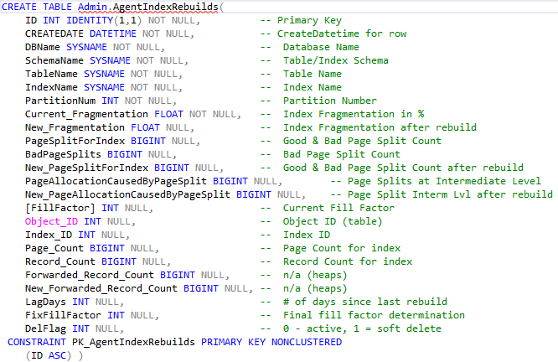
Admin.AgentIndexRebuilds

Slide 33
Approach
Take a technique similar to Ola Hallengren’s defrag script and modify it accordingly
His script “reorganizes” at 10% fragmentation and “rebuilds” at 30% fragmentation
I was already using his script with no Reorganize and Rebuilds at 10%.
Need to track performance and fragmentation for each index (heaps not counted)
Need a table to contain the parametrics involved with the whole rebuild process for each index rebuild
Get TOP 20 indexes with worse fragmentation / bad page splits.
Vary depending odd or even days WHERE clause
Odd days, get top 20 indexes where fragmentation > 1.2%
Even days, get top 20 indexes where bad page splits > 20

Slide 34
Fragmentation
From Ola’s defrag script we can get average fragmentation in percent
sys.dm_db_index_physical_stats
Yields Average_fragmentation_in_percent, page_count, row_count
sys.dm_db_index_operational_stats
Yields Leaf_Allocation_Count, NonLeaf_Allocation_Count

Slide 35
Fragmentation
From Ola’s defrag script we can get average fragmentation in percent
sys.dm_db_index_physical_stats
Yields Average_fragmentation_in_percent, page_count, row_count
sys.dm_db_index_operational_stats
Yields Leaf_Allocation_Count, NonLeaf_Allocation_Count
Extended event (track bad page splits)
https://www.sqlskills.com/blogs/jonathan/tracking-problematic-pages-splits-in-sql-server-2012-extended-events-no-really-this-time/

Slide 36
Fragmentation
But fragmentation consists of
Logical fragmentation
Fragmentation of database file(s) in the file system
Uniform Extents are owned by one object
Mixed Extents can be shared by up to 8 objects
All new indexes are allocated pages from a mixed extent
Index Level fragmentation
Internal fragmentation (too much free space)
External fragmentation (Pages out of order)

Slide 37
Internal Fragmentation
Internal fragmentation is measured in average page fullness (page density)
A page that is 100% full has no internal fragmentation
Can occur with deletes or where next row cannot fit into the existing page.
Will increase I/O
Decreases efficiency of buffer cache
Increases the size of the database file
Great explanation at http://www.practicalsqldba.com/2012/04/sql-server-index-fragmentation.html

Slide 38
External Fragmentation
Happens when logical order of the pages does not match the physical order of the pages.
Measured as percentage of out-of-order pages in the leaf pages of an index.

Slide 39
Code
Review: FillFactorIndexSetup.sql
SQLAgentScriptRebuildIndexes
{Don’t have time to cover scripts in detail; if you want to do so, please contact me and we’ll do a ZOOM meeting and review line by line}
Bad Page Split

Slide 40
Analysis - 1
Initially set up SQL Agent job (nightly) to collect data and vary fill-factor from 100 (default) down
Run during low database activity
As data was collected, added new columns to the history table and revised logic to determine and/or fix the fillfactor for each index
Eventually saw the need to re-tweak fill factors after a period of time (90 days, later changes to 120 days) to allow for new patterns in data access (app changes, data skew)
Bad Page Split

Slide 41
Analysis - 2
Ran data collection on very active client OLTP database
In the first 90 days, only 164 indexes (clustered & nonclustered) were recorded in the history table where the fill factor was “tweaked.”
Year | Data (gb) | Tables | indexes
2019 | 255 | 249 | 694
2024 | 1881 | 442 | 719
Bad Page Split

Slide 42
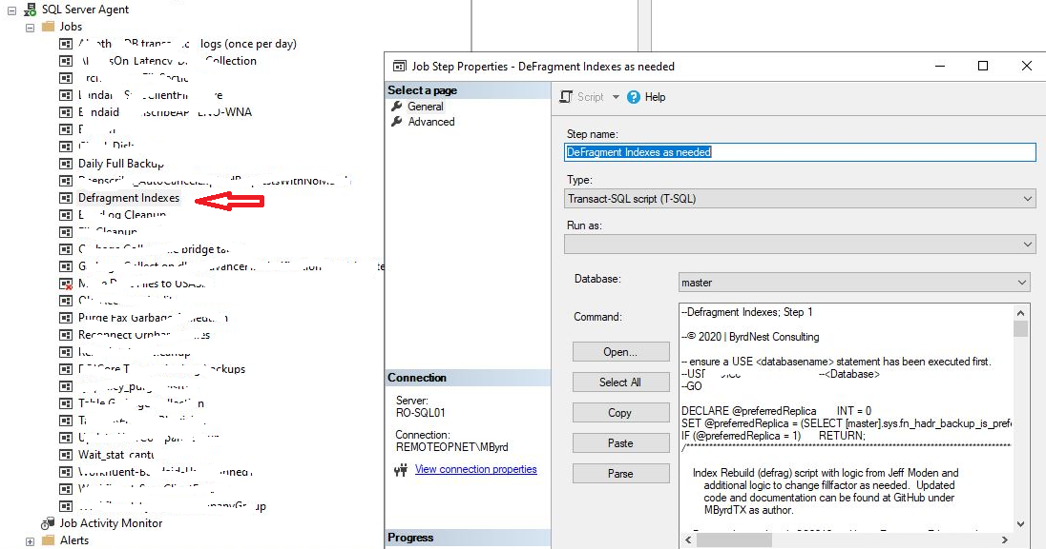
SQL Agent Job
.
Bad Page Split

Slide 43
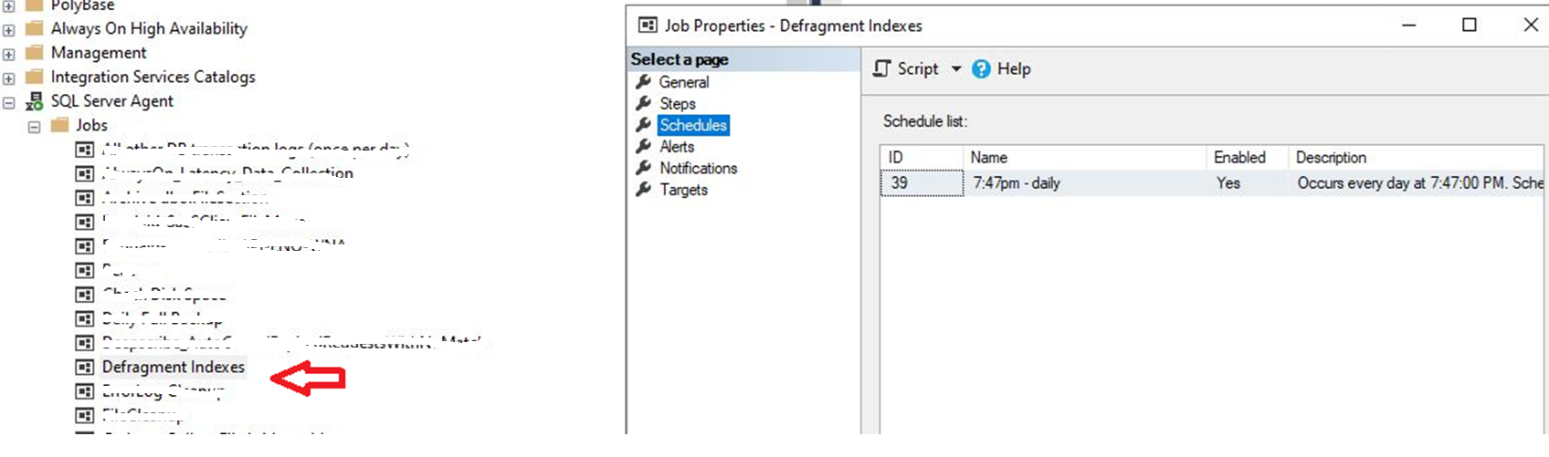
SQL Agent Job
Bad Page Split

Slide 44
Thought process for fixing fill factor
Collect at least 6 data sets for each index
Varying fillfactor -1 or -2 depending on lag from last run
Find the smallest fragmentation
Not the last data set
If the 6th data set fragmentation is the smallest, then continue to perturb the fill factor on the next run(s) for that index
Identify the fill factor for the smallest fragmentation and set FixFillFactor
Script then checks FixFillFactor and stops tweaking when not null.
At least until the retention period elapsed (120 days).

Slide 45
Indexes encountered
Clustered Index
Parent tables: Usually based on a sequential increase (Identity Column)
Child tables: Usually based on Parent Table PK plus the child table’s primary key
FileAttribute table {FileID, FileAttributeID, PK = FileAttributeID}
Non-Clustered Index
Usually based on non-PK column
Bad Page Split

Slide 46
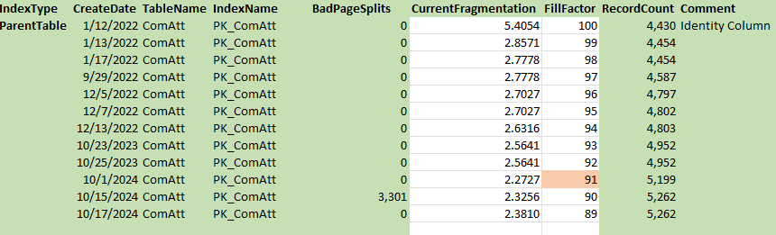
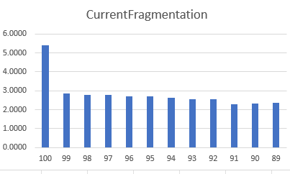
Analysis – 1: Clustered Index based on identity column
Bad Page Split

Slide 47
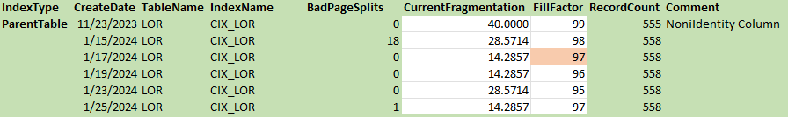
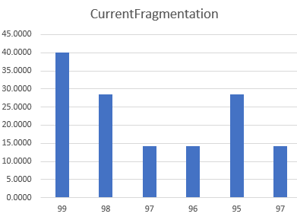
Analysis – 2: Clustered Index (many rows inserted with interior pages)
Bad Page Split

Slide 48
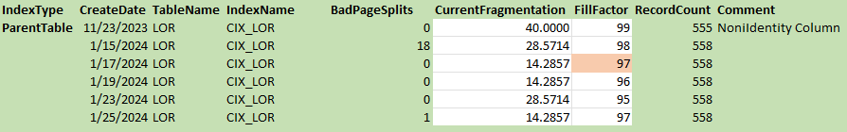
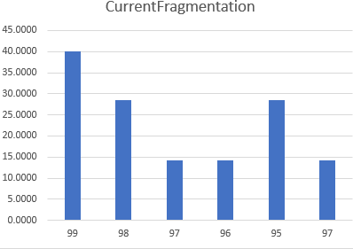
Analysis – 3: Child table, clustered index tied to parent table
Bad Page Split

Slide 49
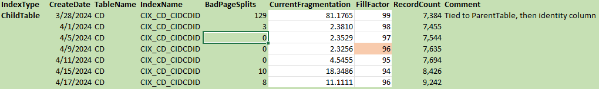
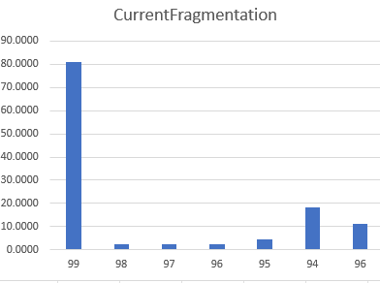
Analysis – 4: Non-Clustered Index (random interior inserts)
Bad Page Split

Slide 50
Analysis:
Unfortunately, we did not have good database benchmarks for performance, but……
Performance tools are like wine – everybody has their preference
I prefer DPA (Database Performance Analyzer)
Originated with Confio
Ties wait times to a specific query plan
Now owned by Solarwinds
Bad Page Split

Slide 51
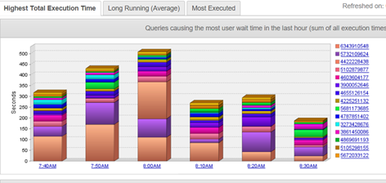
Analysis: DPA screen shot from late Feb 2019 (Typical Server Performance During the Day)
Bad Page Split

Slide 52
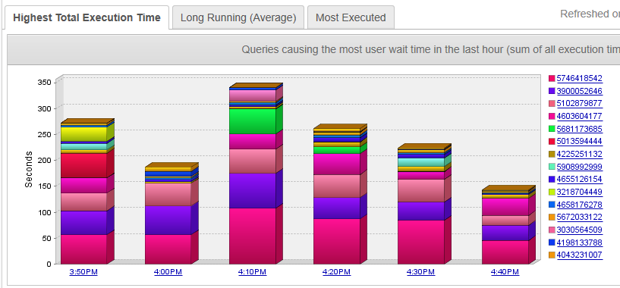
Analysis: DPA screen shot from late June 2019 (Typical Server Performance During the Day)
Bad Page Split

Slide 53
Analysis: Peformance
Overall decrease in database wait times of about 30%
{Yes, I know different times, but screen shots are indicative of performance through the day.}
Bad Page Split

Slide 54
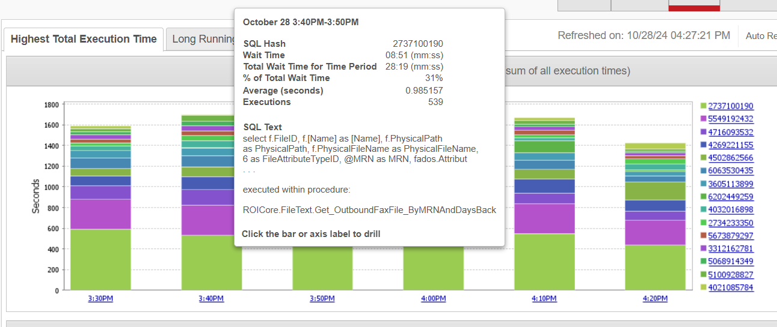
Analysis: DPA screen shot from Oct 28,2024 (Typical Server Performance During the Day)
Bad Page Split

Slide 55
Analysis: Peformance
Overall decrease in database wait times of about 30%
With decreased fragmentation, there are less page splits to wade through for IO range searches
Bad Page Split

Slide 56
Analysis: Peformance
Overall decrease in database wait times of about 30%
With decreased fragmentation, there are fewer page splits to wade through for IO range searches
With an improved fill factor, there are fewer bad page splits.
The cost of a page split can be significant
First, the new page has to be identified, pointers made to it, data movement from the old page to the new page and finally all of this is logged.
Bad Page Split

Slide 57
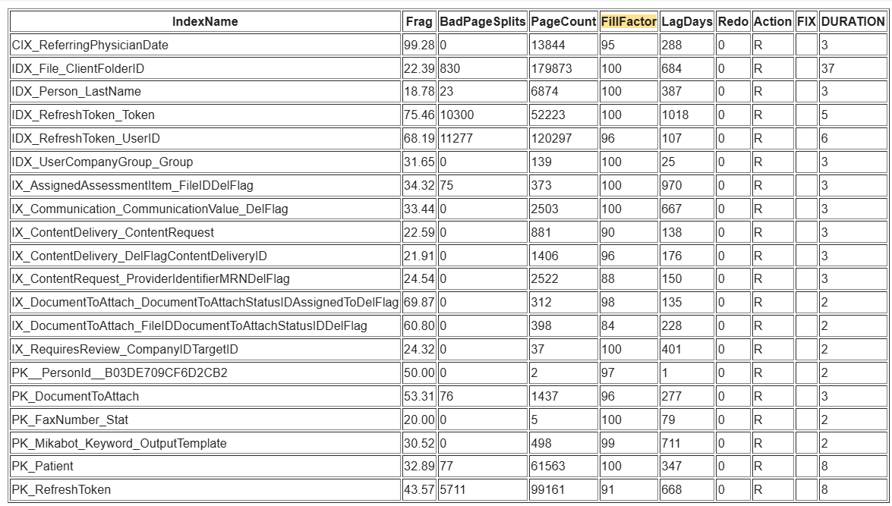
Typical Nightly reports (Weekend; just straight rebuilds, no index variation):
Bad Page Split

Slide 58
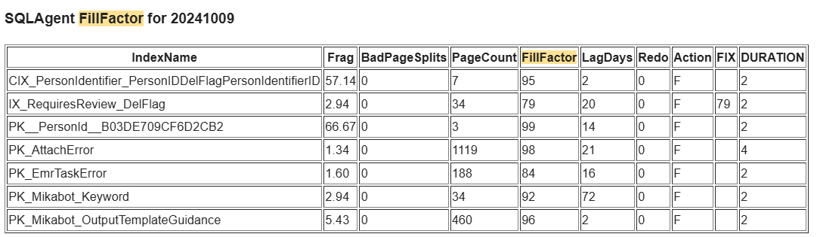
Typical Nightly reports (fragmentation option):
Bad Page Split

Slide 59
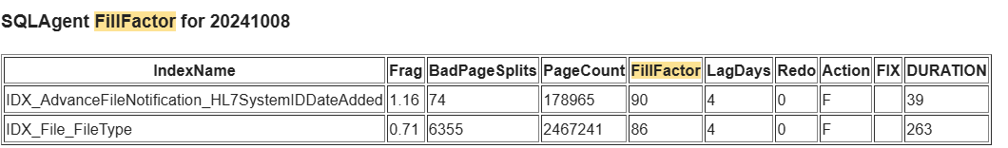
Typical Nightly reports (bad page split option):
Bad Page Split

Slide 60
Requirements:
SQL Server 2012 and above
Enterprise version recommended (OnLine option)
Standard Edition can be used, but have to be wary of blocking/deadlocks.
Data compression = ROW recommended
Already have in Enterprise
Have in SS2016 SP2 and above for Standard Edition
Bad Page Split

Slide 61
Wish List
Add code for multiple databases on the same server
You may want to have a separate database for the history table or history table for each database.
Bad Page Split

Slide 62
Wish List
Add code for multiple databases on the same server
Still, it would be nice to determine the best performance parameter for fill factor value vs pages used.
Bad Page Split

Slide 63
Wish List
Add code for multiple databases on the same server
Still, it would be nice to determine the best performance for fill factor value vs pages used.
Rewrite code (current code is from proof of concept; I’ve intended to do this last 4 years, but it works with almost no production impact.)
Bad Page Split

Slide 64
Wish List
Add code for multiple databases on the same server
Still, it would be nice to determine the best performance for fill factor value vs pages used.
Rewrite code (current code is from proof of concept; I’ve intended to do this last 4 years, but it works with almost no production impact.)
Current fill factor approach not implemented for partitioned indexes (it would be really nice to have to fill factor per partition; that way, the old data partitions could be set to 100% and the active partitions set as needed. {this should be placed on Microsoft’s wish list ☺})
Bad Page Split

Slide 65
Wish List
Add code for multiple databases on the same server
Still, it would be nice to determine the best performance for fill factor value vs pages used.
Rewrite code (current code is from proof of concept; I’ve intended to do this last 4 years, but it works with almost no production impact.)
Current fill factor approach not implemented for partitioned indexes (it would be really nice to have to fill factor per partition; that way, the old data partitions could be set to 100% and the active partitions set as needed. {this should be placed on Microsoft’s wish list ☺})
Try and build in additional features as suggested by the community.
Bad Page Split

Slide 66
Wish List
Add code for multiple databases on the same server
Still, it would be nice to determine the best performance for fill factor value vs pages used.
Rewrite code (current code is from proof of concept; I’ve intended to do this last four years, but it works with almost no production impact.)
Current fill factor approach not implemented for partitioned indexes (it would be really nice to have to fill factor per partition; that way, the old data partitions could be set to 100% and the active partitions set as needed. {this should be placed on Microsoft’s wish list ☺})
Try and build in additional features as suggested by the community.
More testing on performance improvements with firm numbers.
Bad Page Split

Slide 67
Wish List
Add code for multiple databases on the same server
Still, it would be nice to determine the best performance for fill factor value vs pages used.
Rewrite code (current code is from proof of concept; I’ve intended to do this last 4 years, but it works with almost no production impact.)
Current fill factor approach not implemented for partitioned indexes (it would be really nice to have to fill factor per partition; that way, the old data partitions could be set to 100% and the active partitions set as needed. {this should be placed on Microsoft’s wish list ☺})
Try and build in additional features as suggested by the community.
More testing on performance improvements with firm numbers.
Need better way of monitoring
Admin.AgentIndexRebuilds – both manually and also self-reviewing
Any volunteers out there to implement a dashboard????

Slide 68
Conclusions
This whole idea started as a proof of concept
Offers potential performance benefits
Does demonstrate that effective automatic Fill Factor determination IS possible!
Current code production in production on a very transaction oriented DB for 5 years!

Slide 69
Finally
This concept has been copyrighted with the idea that is belongs to the SQL Server Community
I look forward to constructive critique and suggestions for improvement from the SQL Server Community.

Slide 70

Questions?

Slide 72
Mike Byrd
I hope you got something out of this. It has greatly reduced the 2 am phone calls for me!
Your feedback to me is important
Mbyrd@ByrdNest-TX.com
www.TSQLMentoring.com

